Slide 1
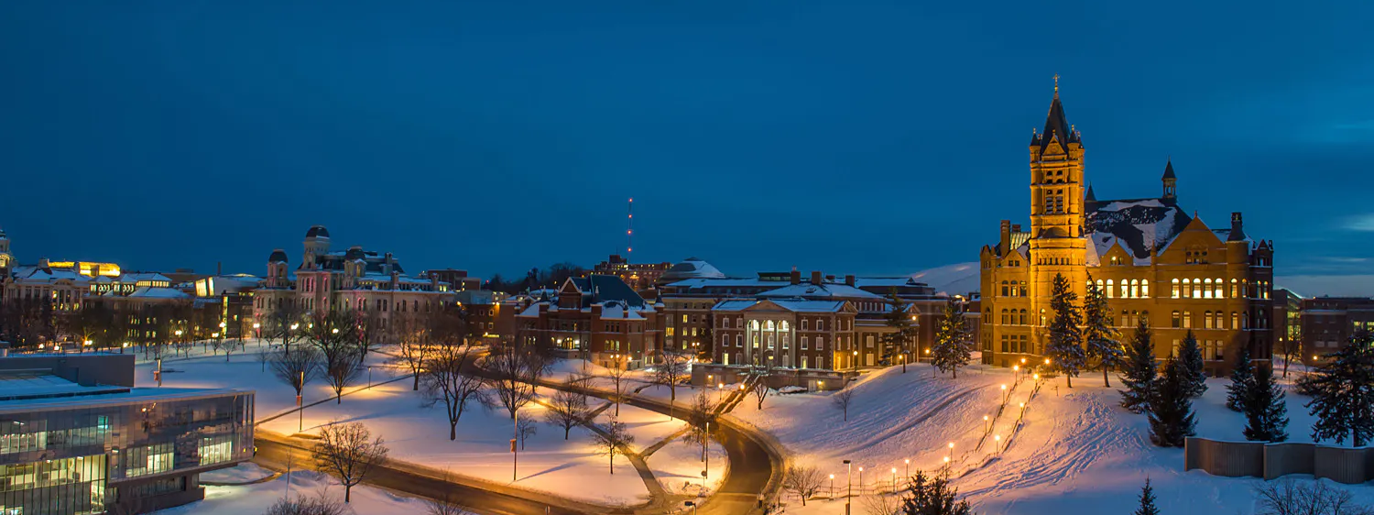
MS Applied Data Science Portfolio Presentation: Jeff Levesque
Notes:
Hi everyone, my name is Jeff Levesque. This is my capstone portfolio presentation for the Masters in Science in Applied Data Science at Syracuse University

Slide 2

Introduction
Showcase coursework that demonstrate learning achievements
Notes:
In this program at Syracuse University, students such as myself are provided an opportunity at the final term of the program to synthesize a presentation.
This presentation consists of a collection of completed assignments and projects, showcasing achieved learning objectives.
I want to mention that my last project chosen in this portfolio was quite involved, so I will try to breeze quicker on the first project

Slide 3
Learning Goals
Collect, store, and access data by identifying and leveraging applicable technologies
Create actionable insight across a range of contexts (e.g. societal, business, political), using data and the full data science life cycle
Apply visualization and predictive models to help generate actionable insight
Use programming languages such as R and Python to support the generation of actionable insight
Communicate insights gained via visualization and analytics to a broad range of audiences (including project sponsors and technical team leads)
Apply ethics in the development, use and evaluation of data and predictive models (e.g., fairness, bias, transparency, privacy)
Notes:
The following list consists of learning goals taken from the “Project Portfolio Milestone Requirement” for 2023.
While I won’t read each item in the slide, I will mention a few general notions.
Prior to this program, I never used R programming, Shiny Dashboard for visualization, or perform much coding with Python dataframes, which is an excellent way to organize data into tabular format consisting of rows and columns.
I also never performed or used any NLP packages in any programming language.
Now that I’m at the end of this program I will briefly highlight later in the last slides, I am heavily involved in the area of data mining in the cloud. This is something I’ve never had interest prior to this program.

Slide 4
Capstone Projects
Course | Capstone Project | Skills
FIN-654 Financial Analytics | Asset/Portfolio Analysis | Python, R, time series analysis, financial analysis, Shiny Dashboard
IST-664 Natural Language Processing | Chatbot | Python, MongoDB / Hadoop, Jupyter Notebook, Time series analysis, Classification analysis, Natural language processing
IST-736 Text Mining | Stock Market Sentiment Analysis | Topic modeling, Sentiment analysis, Time series analysis, Classification analysis, Signal analysis, Data mining, AWS, Jupyter Notebook
Notes:
As we launch into the presentation, I want to list the three different courses I’ve selected that best represents skills I’ve learned in the program.
The first is Financial Analytics FIN-654. This course was taught in R with a focus of financial analysis using a framework called Shiny for visualization.
I listed Python in the skills since I found a way to modularize python code that could be invoked in R using a package called reticulate.
Next is Natural Language Processing IST-664. This course was taught in python and focused largely in NLP concepts.
These include analyzing parts of speech, bag of words, and how to take documents of words and represent them in a numerical matrix in order to perform tasks such as classification or sentiment analysis.
I added the MongoDB in the skills since I used a database for complicated operations of map-reduce to preprocess data on the final project.
Lastly Text Mining IST-736 was somewhat similar to IST-664 but expected stronger python coding skills, with a greater focus on how and what to do with text mining.
Since this was my last project and course taken in the IST program, I attempted to create a much larger project involving a superset of skills from the overall program.

Slide 5
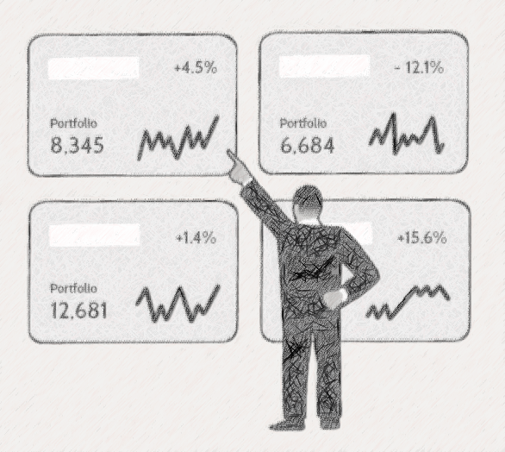
FIN-654
Asset Analysis: visualization using Shiny Dashboard
Notes:
We’ll start with my first final project in Financial Analytics FIN-654. This was one of my earlier projects in the program.
In general, I tried to determine whether hacked or breached were bad investments in the medium term

Slide 6
Objective
Minimum Requirement
Utilize R, perform financial analysis for decision-making, visualize results using Shiny dashboard
Desired Goal
Reuse R code from previous course assignments with supplement python code to perform financial analysis, and machine learning visualized through Shiny dashboard
Notes:
I was able to recycle code from previous assignments to perform analysis as well as visualization using a Shiny dashboard in the web browser
The requirements were pretty straight forward, that is to use R and visualize using Shiny Dashboard for our analysis

Slide 7
Portfolio: Dataset
Method
Final Dataset
World’s Biggest Data Breaches & Hacks
Privacy Rights Clearinghouse
The two datasets were merged into a dataframe in python, then inner joined with a list of stock ticker symbols obtained using the quandl API
blw
dal
fb
gpn
mar
ms
sti
Notes:
I generated a dataset consisting of company tickers that have been hacked or breached and merged them against quandl api.
In hindsight I wish I used something like yahoo finance, since quandl was quite limited and generally didn’t have prices only volumes

Slide 8
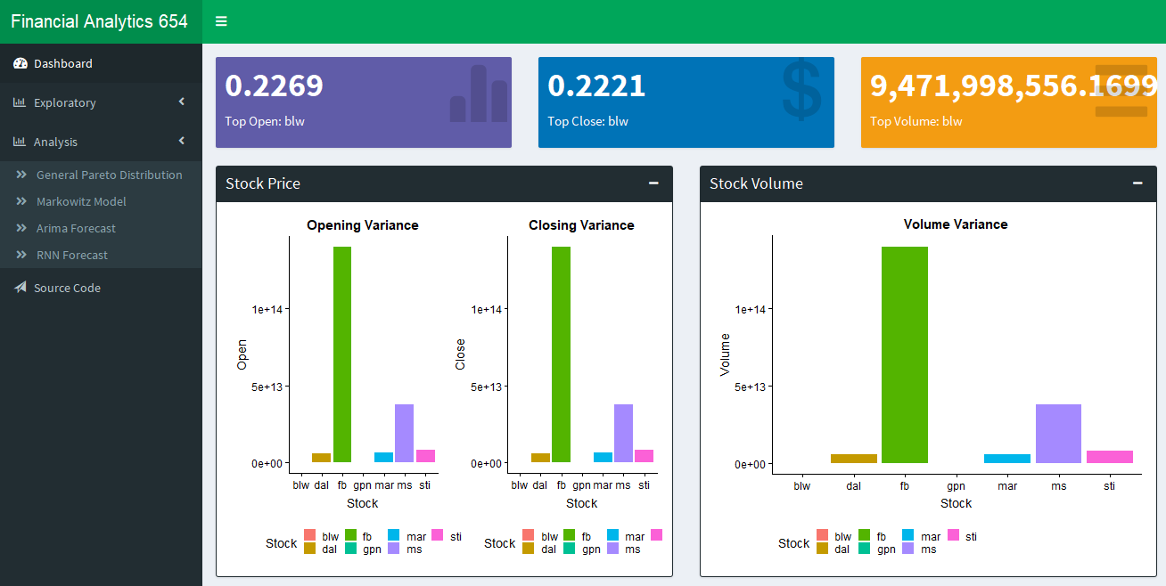
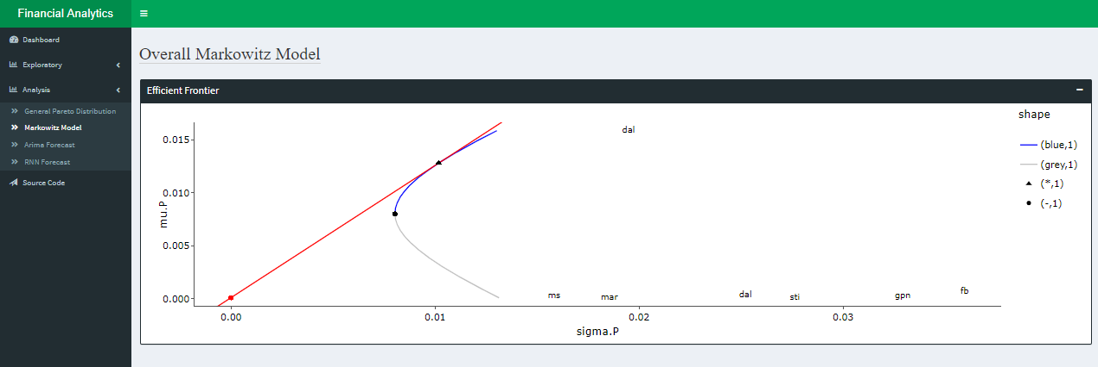
Shiny Dashboard
Variance
Markowitz Model
Notes:
Nonetheless, I was still able to perform some R coding using Shiny for the dashboarding
On the left I was able to show the variance of volume between tickers selected in our dataset. In general, volume is a measure of risk, and can help indicate strong or weak buying pressure for a given stock ticker.
Despite Facebook hack or breach, the high variance we see indicates investors still perceive an opportunity to profit through consistent buying and selling.
Sometimes well established companies are resilient in the medium to long term and often fallback to overall company fundamentals or market technicals
On the right, a Markowitz model was generated using code recycled from an earlier assignment. A tangent line (efficient frontier) on the curve indicates the most optimal distribution within the given investment portfolio.
It would have been interesting to make a slider or input box in the shiny dashboard to allow users to change the weight or timescale causing the efficient frontier to update in place
Similarly, mixing and matching normal tickers against our dataset may have been more interesting

Slide 9
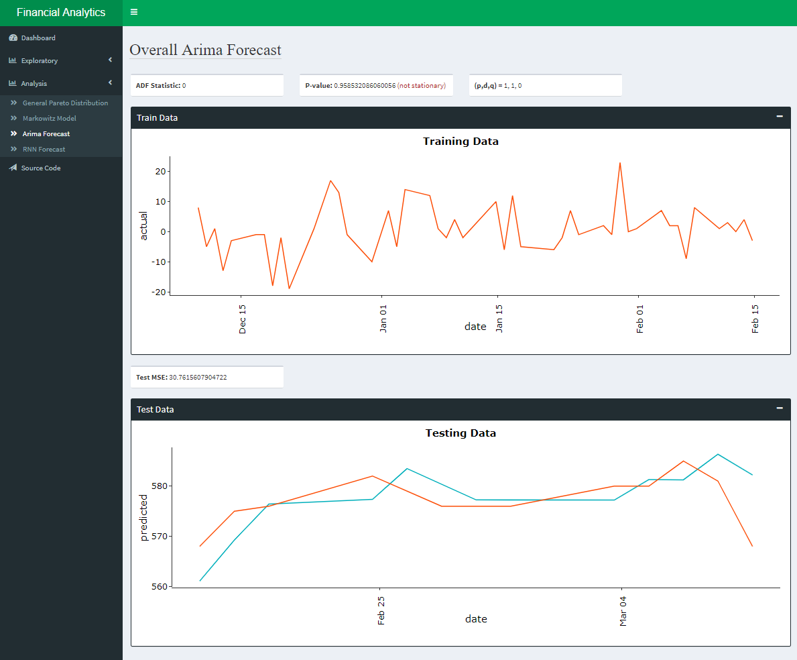
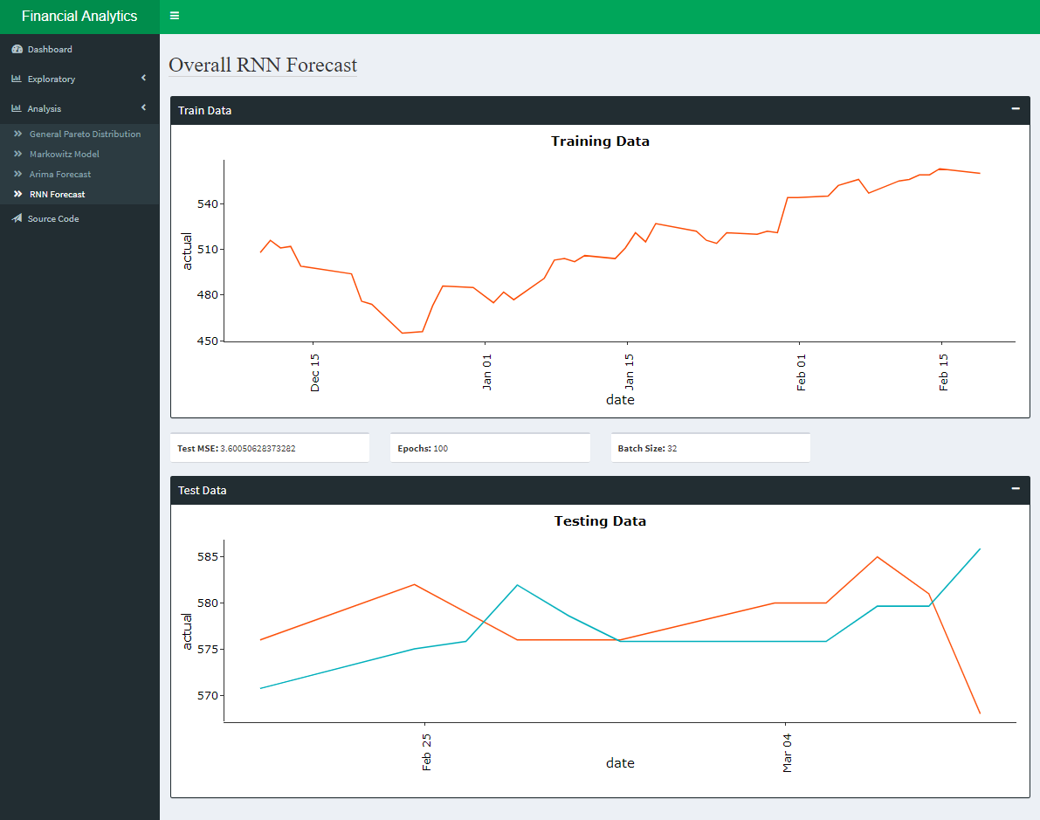
Shiny Dashboard
Arima Model
Neural Network
Notes:
Finally, timeseries prediction and forecasting was performed
While the course heavily focused using R, I wrote and modularized python code to be invoked through R and visualized in the same Shiny dashboard
In general I found the arima model was faster, and more accurate. This could be because the neural network generally requires much more data to allow splitting the dataset into train, test, and validation
In layman's term, neural network reads the same dataset many more times than a traditional statistical approach such as ARIMA
This requires a portion of the original dataset to be removed from the training set to later be used for prediction validation between each data pass
Ultimately this allows the neural network to learn to tweak the model it’s generating. However, this reduces the overall training dataset to learn from
Arima on the other hand doesn’t have this forward and backward propagation and thus able to use all the designated train data for learning on a single pass

Slide 10

IST-664
Ensembled Chatbot: classifiers with neural network
Notes:
In this project, I had a larger ambition of producing a chatbot using materials covered in the short 10 week course
Like the previous project, the final project topic started formulizing around week 6-7 leaving around 3-4 weeks to complete
In order to complete the task, the goal of creating a chatbot needed to be broken up into several problems with a possibility of the first being a sufficient fallback for the overall project

Slide 11
Objective
Minimum Requirement
Question Classifier with Exploratory Data Analysis (EDA)
Desired Goal
Question Classifier → Topic Classifier → Sub Topic Classifier → Specialized RNN/NMT
Obtained Goal
Question Classifier (with EDA) → Topic Classifier → Specialized RNN/NMT
Notes:
In general the desired goal consists of 2 or more classifiers guiding an input to a neural network based chatbot
Firstly, a classifier is trained to detect whether an input is a valid question
If the input is a valid question, the next classifier determines what specialized chatbot to engage
What was desired vs what was obtained was largely a factor of sheer engineering hours needed to investigate various datasets, performing base requirements satisfying the project,
followed by attempting to learn the mongodb map-reduce and NMT neural network framework

Slide 12
Portfolio: Dataset
QuestionAnswerCMU: question-answer pair to train question classifier
Used entire NSF Graduate Research Fellowship Carnegie Mellow University dataset
dataset with question and answer columns
StackOverflow: list of postings grouped by channels used to train classifier to label questions
original dataset 75GB reduced to 200MB
filter only verified answer posts
filter top 10 channels
Sample 20% remaining
Reddit: json data used to train RNN based NMT chat agent
one month (12/2005) of reddit data (12/2005 – 05/2006 available)
mapreduce every comment id with parent comment id
Notes:
Originally I discovered the entire reddit data first half of 2006 could be downloaded. I intended to use this dataset for all classifiers and chatbot.
My partner discovered the reddit data wasn’t tagged and could not be used to train classifiers. Luckily I found a stackoverflow dataset labeled by channels
At this point we felt overwhelmed with the project deadline
My partner and I agreed he was going to train a classifier on predicting channel categories including supporting exploratory data analysis
Myself on the other hand would focus much less on exploratory analysis, and would train a question classifier on a third dataset I discovered from Carnegie Mellon
The idea was that I was going to expand the base minimum requirement. If my classifier detected a question, it would initiate my partners classifier to suggest a channel topic in stackoverlow
Since my part was simple compared to his, I expanded my efforts storing the reddit data in mongodb in order to transform the data using a framework called map-reduce
Ultimately the transformed data would be a sequence of statement-response pairs needed to train the chatbot

Slide 13
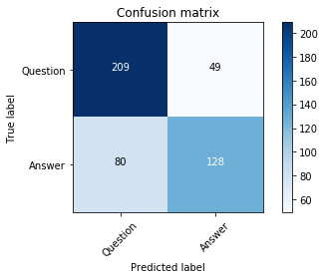
Classifier: question-answer
Random Forest
Roughly 72% accurate
Train time 5.05 seconds
Prediction: 0.29 seconds
Notes:
Using a jupyter notebook, and preprocessing data using standard NLP tokenization techniques, I was able to train a classifier to predict whether a sentence was a question
For such a simple task, I actually expected results to be slightly better than received
Nonetheless a 72% accuracy was achieved, and the corresponding random forest model was pickled.
This is similar to creating a zipped file of a directory containing files representing the trained model
At the end of this project, when I created an interface between the various trained models, it would essentially unpickle a given model, which is equivalent to unzipping a tarball so it can be executable in python

Slide 14
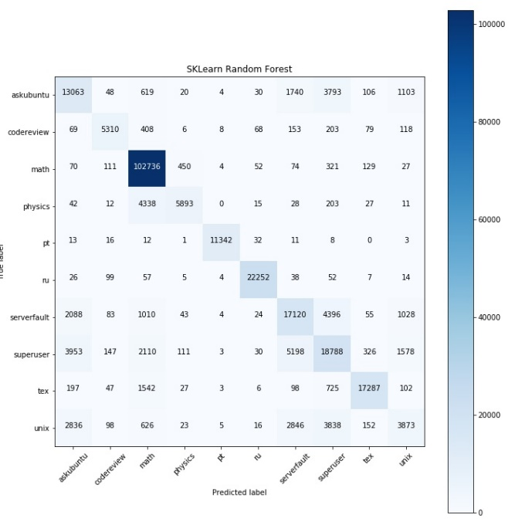
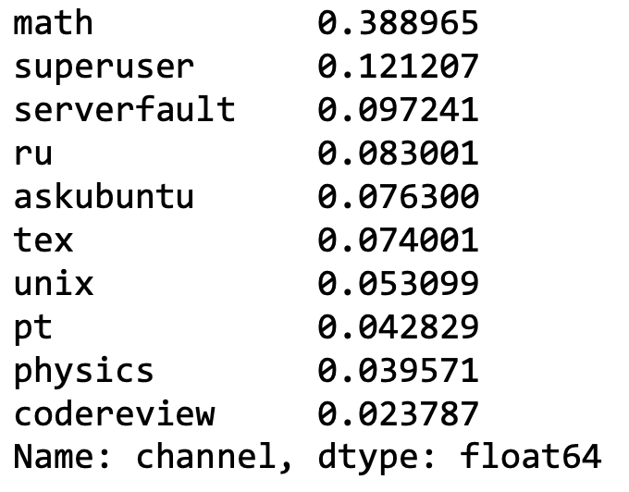
Classifier: question-label
Random Forest (73.5%)
Labels
Notes:
My partner trained a single multi-class classifier to predict a label for a supplied sentence
However, the data used to train his model was quite unbalanced. We see a significant majority of content was related to math questions
From the above confusion matrix, a sentence related to unix could almost equally be predicted incorrectly as the superuser label
I think an improved approach for above, is to potentially train two models
The first is simply a classifier to predict either math or not math, while a second is a multi-class classifier trained to predict remaining labels not math
Essentially the non-math class would be trained with all and only non-math labelled data
If the math classifier predicted math above a threshold say 85% accuracy, then we conclude the sentence is math related
However, if math is not detected with the math classifier, then a second multiclass classifier could be invoked to predict if the sentence is any of the remaining class
At this point the highest prediction score between the two classes could be chosen as the final result. This approach could easily bring this task above 85% accuracy threshold

Slide 15
RNN: NMT chatbot
Execution
Result
root@development:/vagrant# python3 run.py
Starting interactive mode (first response will take a while):
> hey, where is billy?
/usr/local/lib/python3.5/dist-packages/sklearn/base.py:251: UserWarning: Trying to unpickle estimator DecisionTreeClassifier from version 0.20.1 when using version 0.20.0. This might lead to breaking code or invalid results. Use at your own risk.
UserWarning)
/usr/local/lib/python3.5/dist-packages/sklearn/base.py:251: UserWarning: Trying to unpickle estimator RandomForestClassifier from version 0.20.1 when using version 0.20.0. This might lead to breaking code or invalid results. Use at your own risk.
UserWarning)
hey jimmy, maybe checkout ['math']
>
NMT generated response with ‘bleu’ score less than 12
NMT response suppressed
question-label classifier (fallback) response returned
Discussion
NMT uses ‘bleu’ scoring scale for responses
change default ‘bleu’ metric to ‘accuracy’
Our codebase arbitrarily suppresses NMT response when bleu best_score < 12
never spent time investigating NMT scoring configuration
ingested data in mongodb should be sufficient quantity at least low quality NMT chatbot
Needed more time to verify map-reduce was correctly formatted into NMT
Notes:
In the last component of this project, I had to learn during my own time how to use the mongodb database, as well as its map-reduce functionality
Essentially the reddit data needed to be preprocessed, and broken into a series of question-response pairs through an extract transform load like process for unstructured data
Basically each post having some ID could have any number of response with a matching parent ID. Each of these ID and parent ID pairs would be grouped through the map-reduce process
Once the data was transformed and inserted into the database, we were able to train a neural network model using many of these post-response pairing
We used a neural network framework called NMT which is well known for language to language translation. For example converting English sentences to French. I used this framework instead to build a chatbot in the same language
I had maybe 1 week to learn and try to integrate this new NMT neural network framework with the map-reduced dataset I created
I never got enough time to check under the hood of the NMT framework to understand confidence scores could be customized. In truth we had enough data for a working chatbot
But, I wanted to show on the left-side a workflow where the chatbot could not return a sufficient response, for example responses with poor quality confidence score
For this example, I said if NMT returned a ‘bleu’ score less than 12, the chatbot response would be suppressed, then my team members classifier would be initiated
However, as mentioned earlier, the label classifier was quite imbalanced. When a generally vague sentence is supplied, the returned result can easily be the label math

Slide 16

IST-736
Market Prediction: using sentiment analysis
Notes:
Finally the last project in our capstone portfolio is IST-736
This course was focused on two general aspects data-text mining, as well as machine learning based on text obtained
Being the last course taken in the program, I wanted it be a little more special and representative of previous courses taken in the program
The topic chosen was whether market sentiment could predict aspects of the stock market
Like IST-664 fundamental concepts such as exploratory analysis for NLP were conducted as we’ll see in next slides, which this time served more on a practical sense determining what subtopics to target and try to analyze
However, unlike the previous two courses, this course provided better guidance on how to obtain data through various APIs rather than hoping relevant datasets were available for download online

Slide 17
Objective
Minimum Requirement
Text Mining → Exploratory Data Analysis → Sentiment Analysis
Desired Goal (obtained)
Text Mining → Exploratory Data Analysis → Sentiment Analysis → Time Series with Granger Analysis
Text Mining → Exploratory Data Analysis → Classification Analysis
Extra (obtained)
Performed comparison of ARIMA vs LSTM for time-series prediction of stock volume
Notes:
Before jumping into further slides, I want to generally present how the project was organized on a high level
First I developed python code to extract tweets from various financial analyst using a twitter API
Using this dataset, I performed exploratory data analysis using LDA, or a natural language processing technique that groups similar words together
Once I had a collection of groups of words, I was able to determine which stock ticker were generally trending for a given analyst
Refining code from FIN-654 I was able to obtain ticker data based on what was trending
Next I converted tweets for each financial analyst to numerical sentiment scores for each positive, negative, and neutral sentiment
Borrowing a granger financial hypothesis test, I tried to determine whether one time series could predict another time series, namely whether any of the sentiment time series could predict the ticker time series
Additionally, I was able to vectorize all tweets for a given analyst into a distribution of word occurrences, a weighting of how many times a word has occurred in all tweets for given financial analyst
I trained this vectorized data using a classifier against two labels, momentum up and momentum down. These momentum values were generated using a custom signal analysis stepwise equation I created
Basically if a lagged ticker value exceeded for example one standard deviation over the trendline, it received a value of one, or two if it was two standard deviation above the trend, the inverse was similarly defined
This essentially provided me a standard gauge to determine whether tweets from a financial analyst could predict the momentum of ticker value
So the take away approach is two folds, first determine whether granger causality test, could indicate whether analyst sentiment could predict ticker time series selected from exploratory analysis
Second, if YES, use the classifier trained for the given financial analyst to predict whether future ticker price will be bullish, very bullish, bearish, or very bearish

Slide 18
Portfolio: Dataset
Twitter
Quandl
Tweets from financial analysts (roughly 3200)
LizAnnSonders
ReformedBroker
SJosephBurns
TheStalwart
JimCramer
Daily short-volume & total-volume (09/15/2014– 09/15/2019)
APPL
AMZN
GOOGL
MMT
VX1
NASDAQ
SPY
MMM
QQQ
RWTC
CON_15YFIXED_IR
CON_30YFIXED_APR
Notes:
Based on what was discussed, I chose to track 5 financial analyst using the twitter API
At the time when I wrote code, I could only query the most recent 3200 tweets for a given twitter handle
I stored these as flat files on my local system, no databases involved
My python script also queried the quandl api which was a much larger timeseries scale, so joining the two generally didn’t cause loss of twitter data
I mentioned earlier, I wished that I used yahoo finance API, since it provides more data including company tickers, as well as ticker price and not just short or total volume

Slide 19
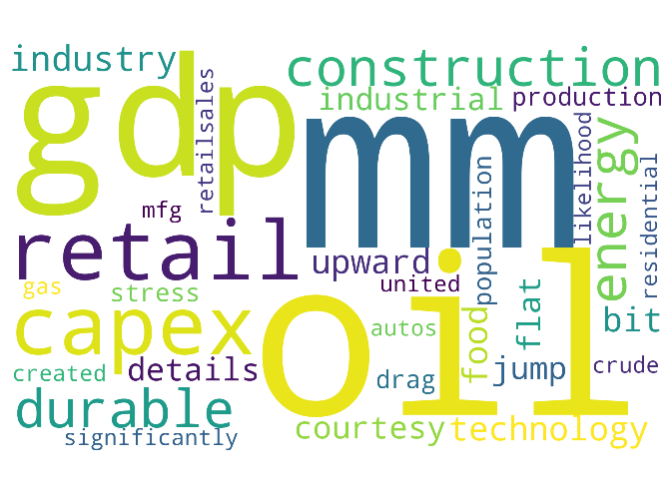
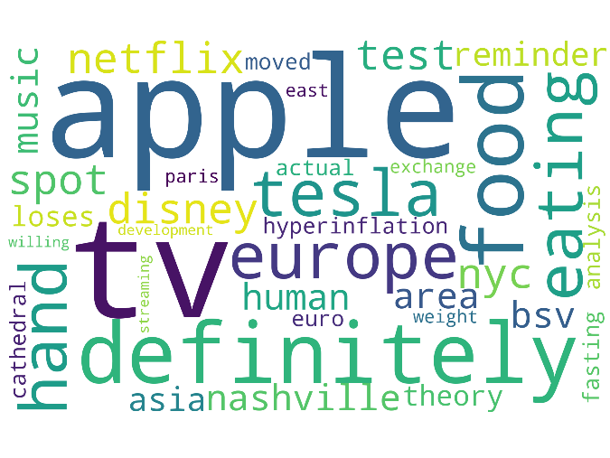
Topic Modeling (LDA)
LizAnnSonders
TheStalwart
Notes:
I performed topic modeling using an algorithm called LDA, and configured the algorithm to return 10 topics for each financial analyst
Since I performed 10 topics for each financial analyst, it means I generated 50 total topics
In this slide I chose to show two word clouds out of the 50 generated to give visual sense of how LDA works
From here, we can easily see what general things a given financial analyst discusses in the course of 3200 recent tweets
In the case of TheStalwart, I may choose to obtain and analyze apple, tesla, or Netflix ticker data
On the otherhand, for LizAnnSonder, I may choose some oil company maybe exxon or chevron, or metallica metals corp
However, if I think the word oil is too vague, then I should have 9 other topics to review and consider

Slide 20
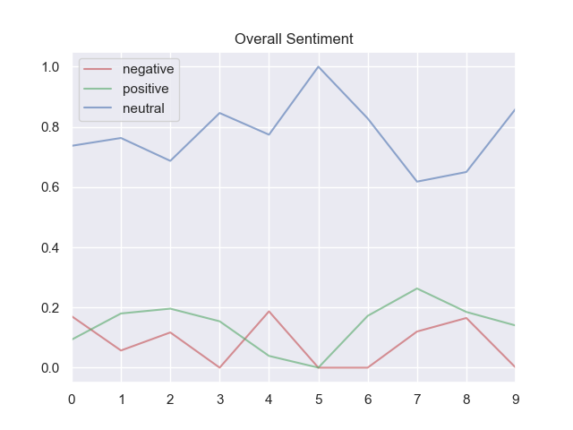
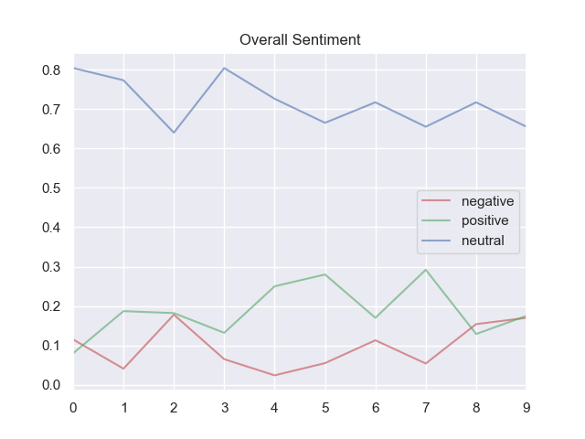
LDA Sentiment: 10 topics
LizAnnSonders
JimCramer
Notes:
Using LDA topics, I performed some due diligence and attempted sentiment analysis of each topic.
Not shown in this slide, I also performed as mentioned earlier, the same sentiment analysis of each tweet for a financial analyst as a function of tweets in sequential datetime order
This provided me timeseries dataset for each sentiment positive, negative, and neutral for the most recent 3200 tweets on each financial analyst

Slide 21
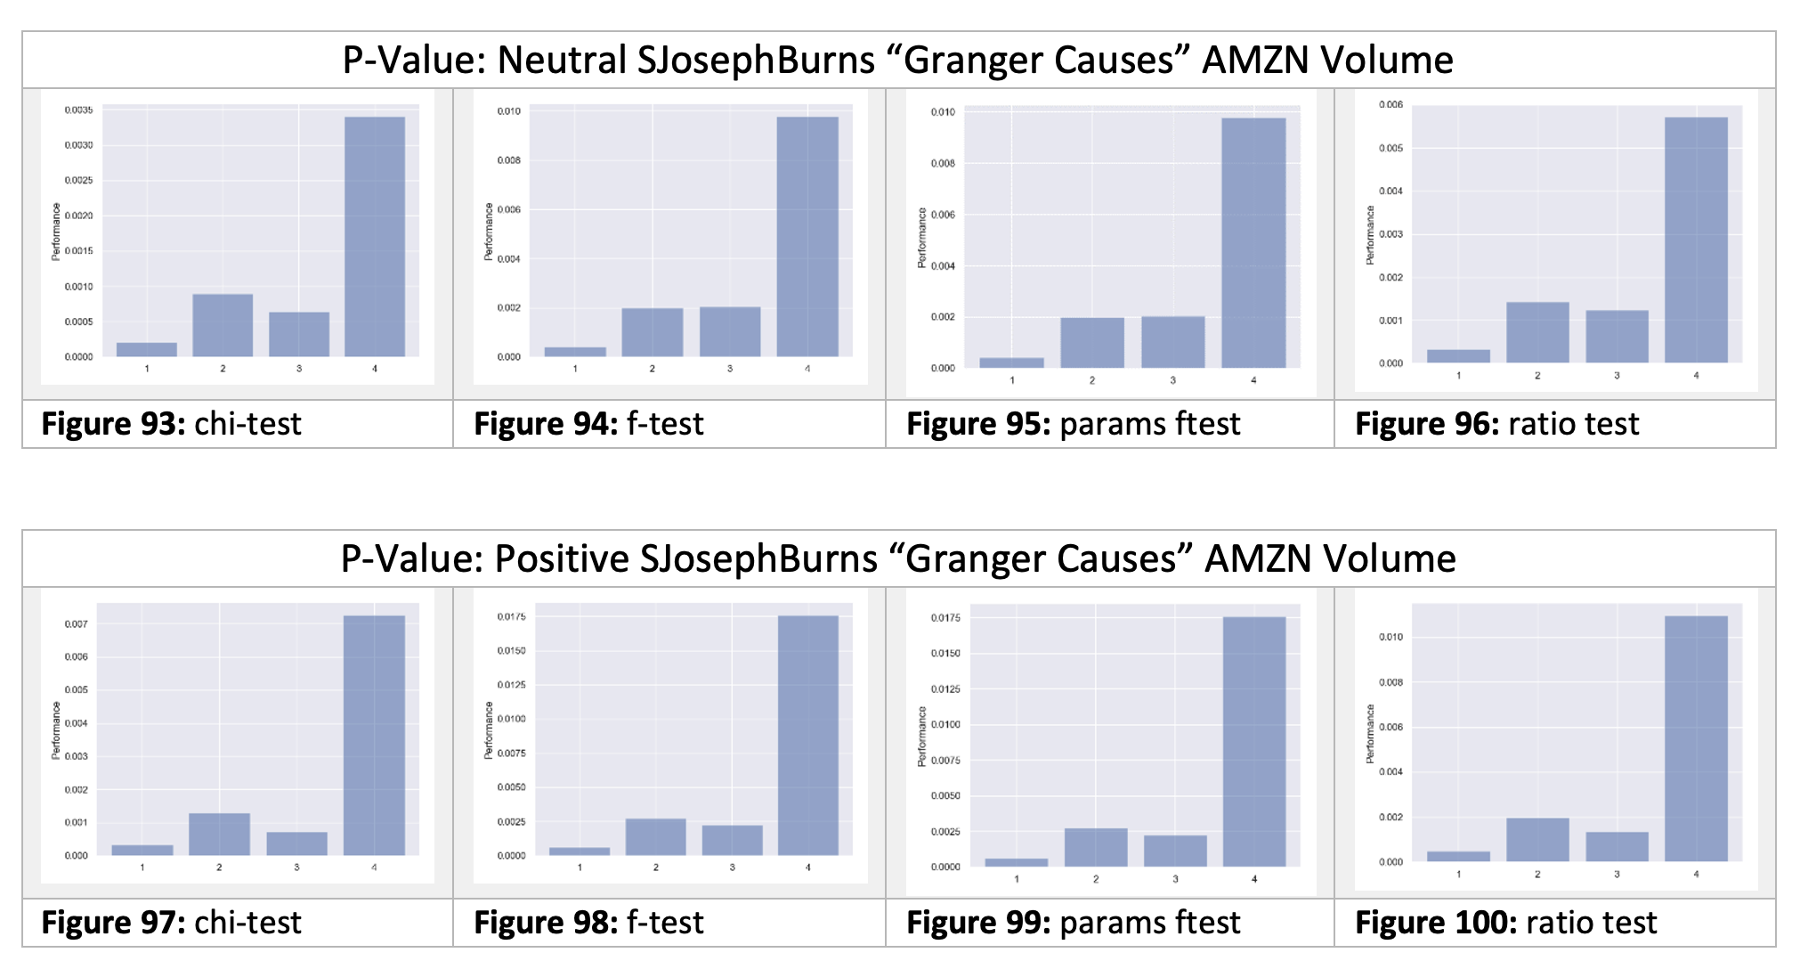
Granger Causality
Notes:
Having the sentiment timeseries and ticker data determined by LDA topic modeling and downloaded through the quandl api, I was able to perform another brute force shotgun analysis
Namely, I performed granger causality hypothesis testing between the VIX and LizAnnSonders three sentiments as a baseline measure
Next, I performed the same hypothesis testing between every timeseries combination of the five financial analyst, against roughly 12 different ticker symbols to see if result were better than the baseline
Generally, with hypothesis testing we want a score of less than 0.05 relevance
Similar to the previous slides, I’m only showing two results of many, this is just to give a representative idea of what some or most results look like
As we can see we have some good results, where the relevance value using a k-fold like analysis generated scores much less than the 0.05 threshold
With these results, a general consensus could be said that “SJosephBurns positive sentiment granger causes Amazon volume” at a 0.05 significance level

Slide 22
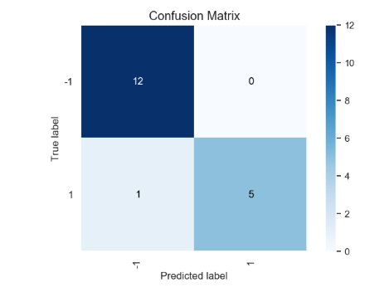
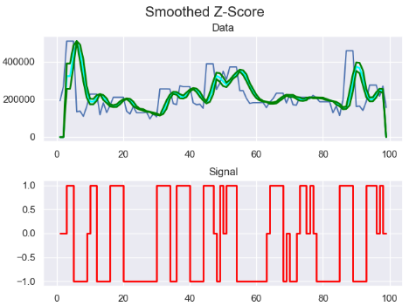
Tweets (TF-IDF) predict +/- Volume
SJosephBurns: BNB Results
AMZN: Z-Score Indicator
Notes:
Since we were able to determine via the granger test that SJosephBurns positive sentiment could forecast ticker momentum, we could proceed to the second case
That is train a classifier to determine whether tweets could predict predict whether ticker value (or volume) would increase or decrease based on the customized stepwise equation we developed
Ultimately, I was able to train a Bernoulli Naïve Bayes classifier which was roughly 94% accurate in predicting whether a tweet could forecast increase or decrease in stock volume
Again, the analysis was performed for each of the 5 analyst for a range of tickers defined by topic modeling for each of the three sentiments
But, I’ve only showed one result to give a representative idea of the analysis that was performed
And to reiterate, at this pointed we’ve proved using the tools and methods we’ve selected two points:
first, granger financial hypothesis test was able to conclude that positive sentiment from SJosephBurns could forecast AMZN ticker volume/price
second, general tweets from SJosephBurns could forecast future momentum of AMZN ticker volume/price
for example, are investors going to be buying and selling a high volume, or very high volume, these could serve as indicators of risk and opportunity for gains to be made

Slide 23
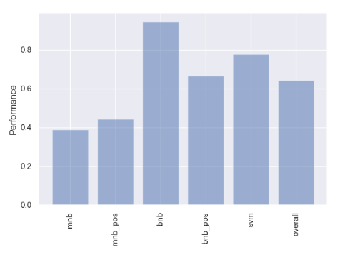
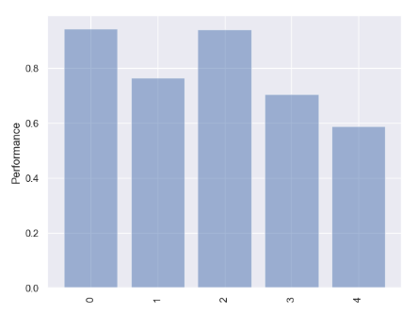
SJosephBurns: Model Comparison
Model Selection
K-Fold (BNB)
Notes:
Before closing out, I want to mention that I didn’t arbitrarily select Bernoulli Naïve Bayes for a classifier because it sounds fancy
I actually ran a series of benchmarking to determine out of a selection of different classification models, which would perform best on the SJosephBurns dataset
Then I ran a K-fold analysis, which basically runs the same model 5 times against the same dataset (with different sampling) to see if model performance is consistent
Overall Bernoulli Naïve Bayes generall performed best
I apologize again, while this slide shows model comparison for SJosephBurns, I want to stress that I performed this type of benchmarking for every combination of financial analyst

Slide 24

Follow-up
AWS Integration: streaming data
Notes:
This basically concludes my presentation. But, I want to address one final question why I haven’t submitted my portfolio since I’ve completed all my requirements since 2019
The answer to that is largely because I had no requirements at my profession that needed this degree immediately
Further, I was more focused on expanding the previous three projects into a more big data application, in the cloud
I was more engaged learning how to do cloud, and how to do big data, and this consumed me more than wanting to official graduate

Slide 25
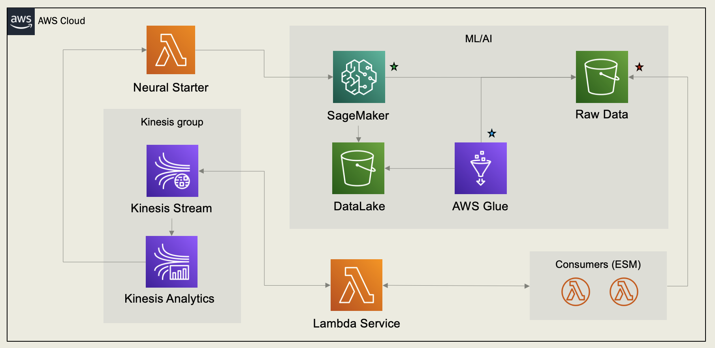
AWS Glue executed as nightly batch process to reduce costs, since spark stream via Glue, Kinesis Analytics, EMR or some other variant will incur higher charges.
Storage lifecycle configured to retain objects for 48 hours. This will reduce cost, and more importantly optimize spark (via AWS Glue), since corresponding jobs will have to list/iterate objects in the bucket (i.e. Glue bookmark)
DataLake
While SageMaker utilizes optimized Parquet files (from AWS Glue), if more recent data is needed (present day), then RAW Data will be accessed as needed.
Notes:
So here is an architectural diagram which has been running for the last 2.5 years non-stop
It’s actually only a small subset of what I have already built in AWS
Several of the pain points with the project based courses in this Syracuse program were data related, so that was in part of the motivation of the cloud system I have built and running today
It consists of my own api that collects stock market data every minute for roughly 200 ticker symbols
They get dropped into a stream, and several processes organize this streaming into a datalake partitioned by sector, industry, year, month, and obviously the ticker symbol itself
This datalake allows me to perform big data like analysis using spark or Hadoop as well as machine learning and neural network training we saw earlier

Slide 26
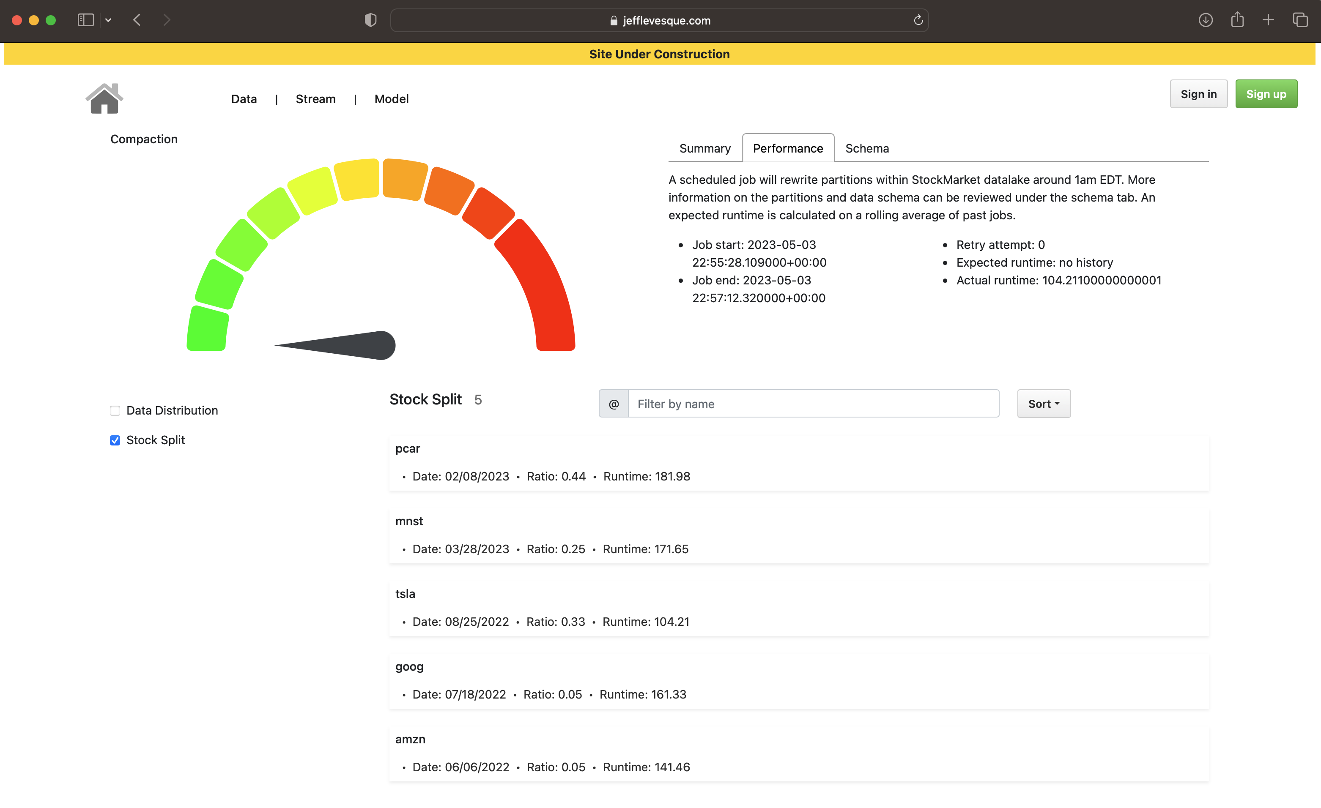
Automated Stock-Split Detection
Notes:
This spring, I spent time building a frontend website that displays some metrics for this datalake architecture
For example stock-splits can happen any day of the week. When this occurs the given ticker price could change maybe 4 to 1
This means all data points collected are no longer valid. For example tesla could be worth $400 yesterday for one share, and today it could be split into 4 shares at $100
So, I have an automated system that checks every morning between 12am and 1am for stock split happening that morning
If a ticker that my system is tracking is found to have a stock-split, the automated systems will backfill and correct the stock ticker price
We can see in the screenshot here, this stock split was actually performed on the tesla ticker and took roughly 1.5 minutes to complete
There are some additional features of this system that are nearly complete. But, I will conclude here. The purpose of the last two slides was really to show that while I have officially concluded my time within the Syracuse program,
my learning and application of data science whether as a hobby or practitioner will continue on regardless

